Slide 1
Travel to
Kazakhstan.
Aliyeva Samira
9th grade

Slide 2
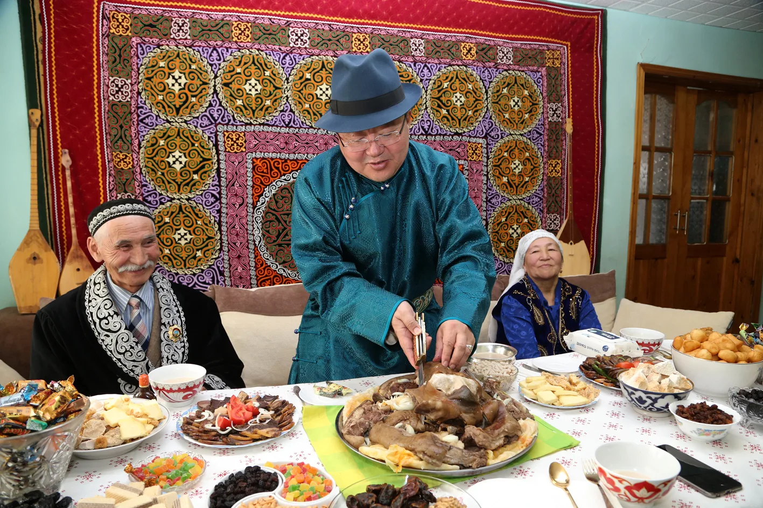
Culture and traditions
Kazakhstan is a country with a rich culture. The traditions of this country were formed in ancient times. One of these customs is konakasy. This is due to the hospitality of the kazakhs. They invited random travelers or special guests home and treated them to delicious food. Previously, this could be seen often, but over time it began to be forgotten.

Slide 3
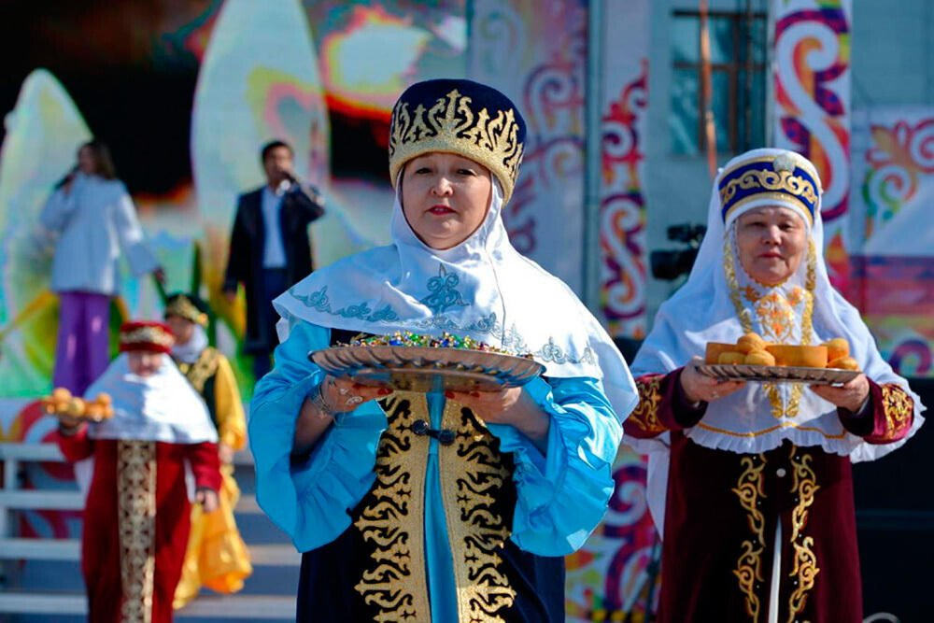
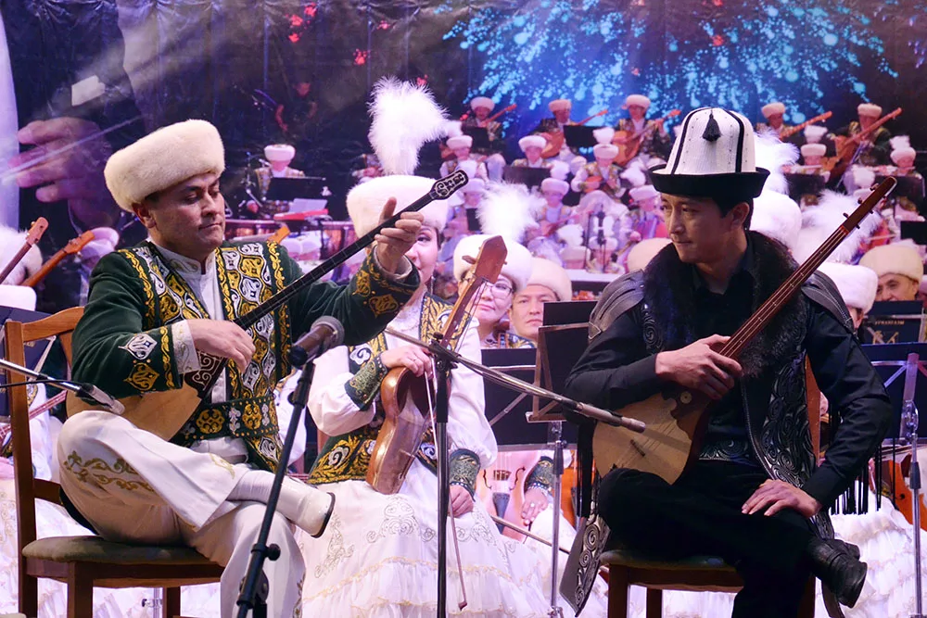
Another tradition without which no celebration is complete is aitys. Aitys-musical competition of 2 akyns. They sit opposite each other and play a musical instrument and sing a song. But the song must be improvised. After this, the one who performed better becomes the winner.
Shashu is a tradition of showering people with candy. It can often be found at weddings or the birth of a child. Sweets symbolize prosperity and abundance. And if you manage to catch them , then there will be joy in your home.

Slide 4
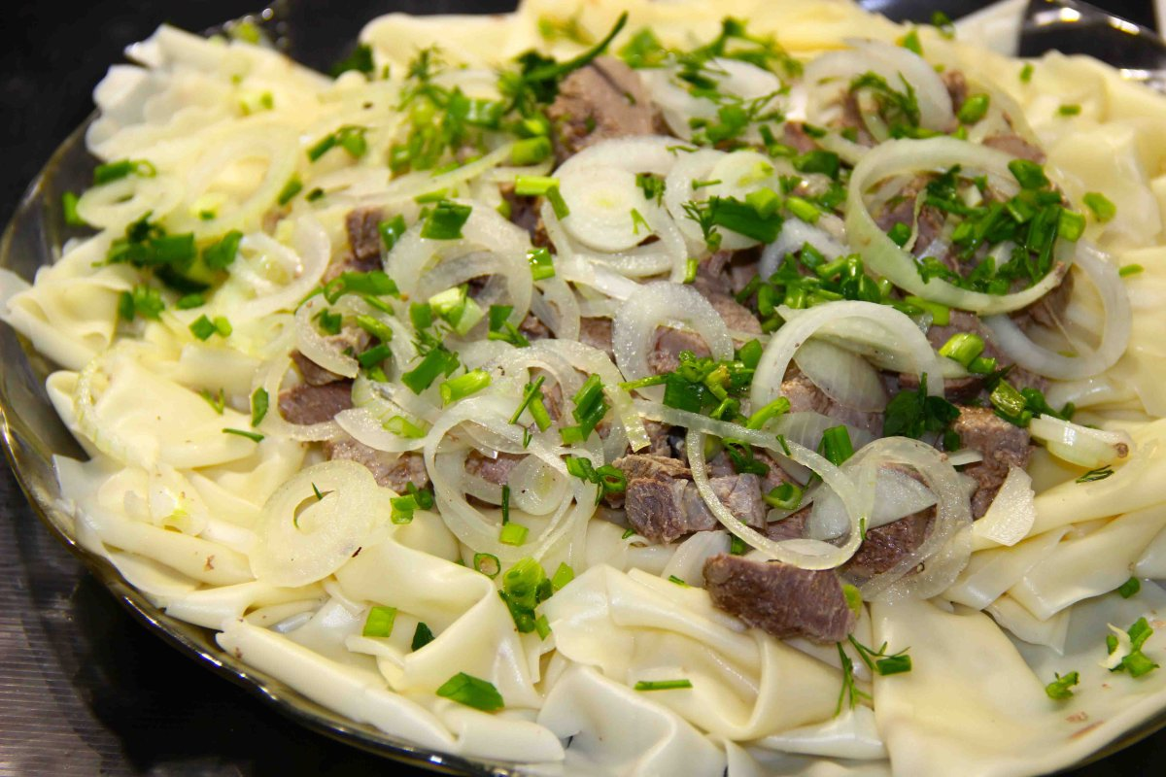
National cuisine
Beshbarmak is a traditional Kazakh dish. It is main ingredients are dough, onions and boiled meat(usually horse meat). Sometimes kazy is added. This is a sausage made from dried horse meat. Translated, it means 5 fingers, as it is customary to eat it with your hands. It arose with the advent of nomadic cattle breeding , in the eighth century BC. Rest assured , this dish is incredibly delicious!

Slide 5
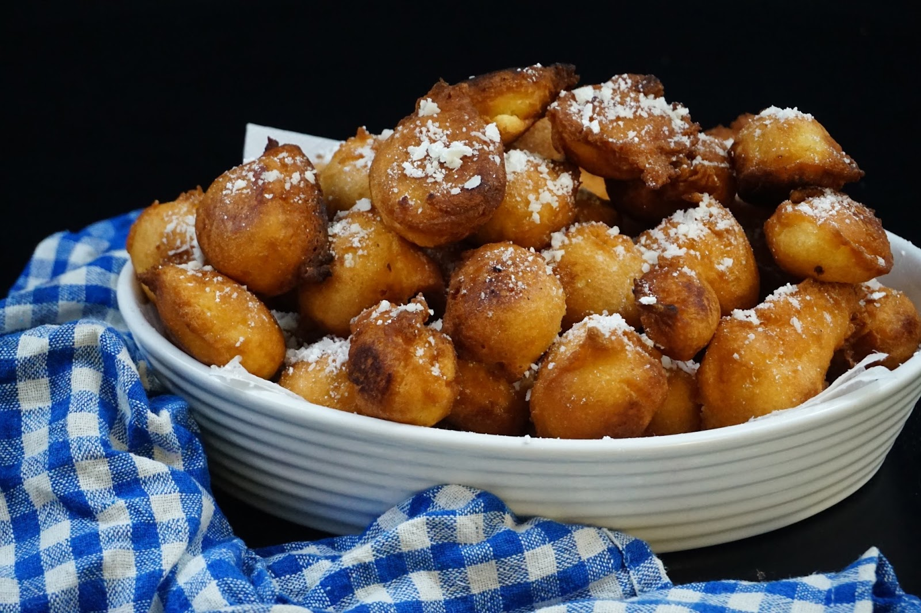
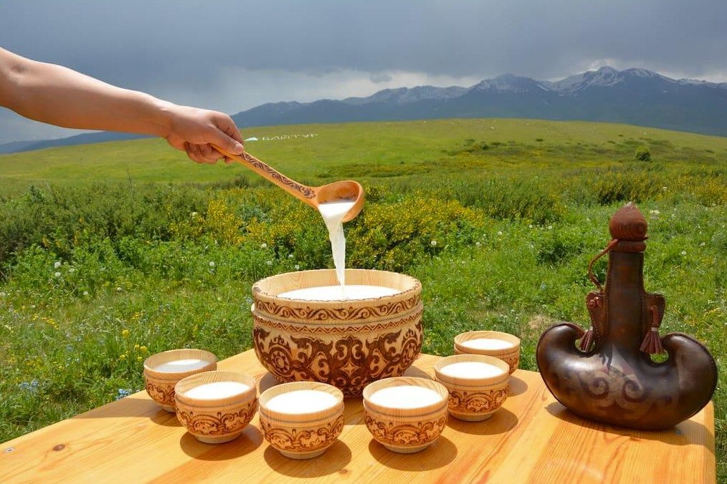
Bauyrsaki is another traditional dish Kazakh cuisine. It is made from pieces of dough fried in oil and sprinkled with powdered sugar on top. They symbolize the sun and happiness, so they are treated to the most dear guests.
And of course, where would we be without drinks? Kumis is a white fermented milk drink made from mare milk. It invigorates the body and is also very useful. Kumis promotes digestion and contains various vitamins. The nomadic tribes of the Central part began to prepare it for the first time.

Slide 6
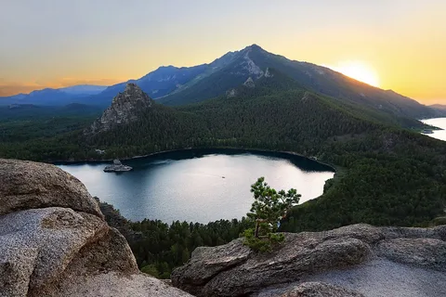
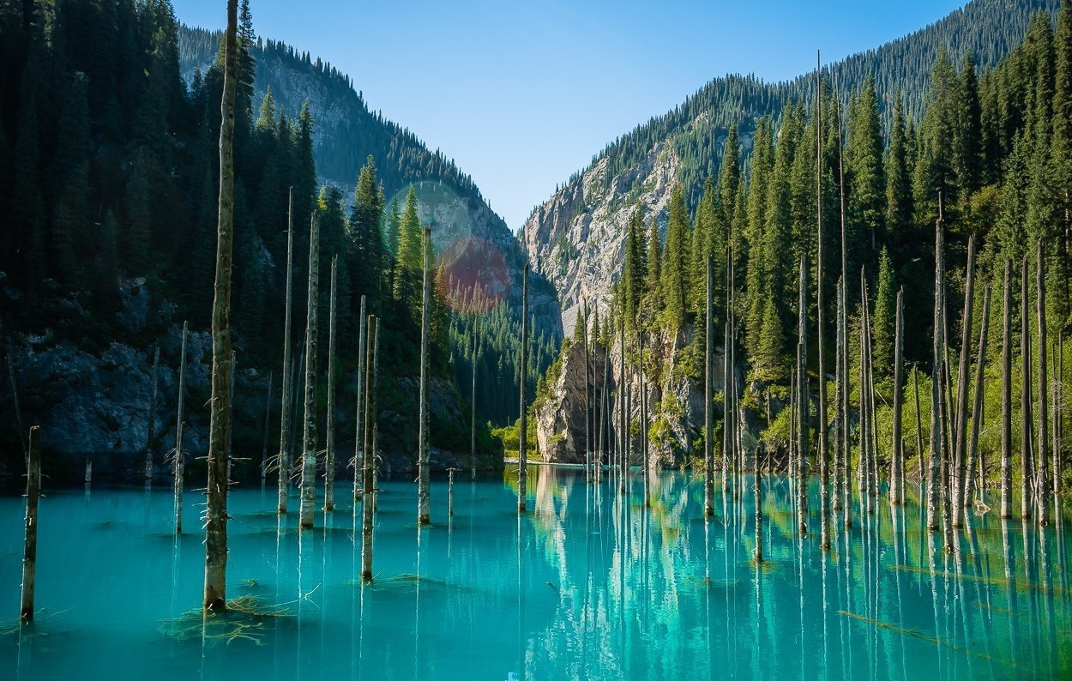
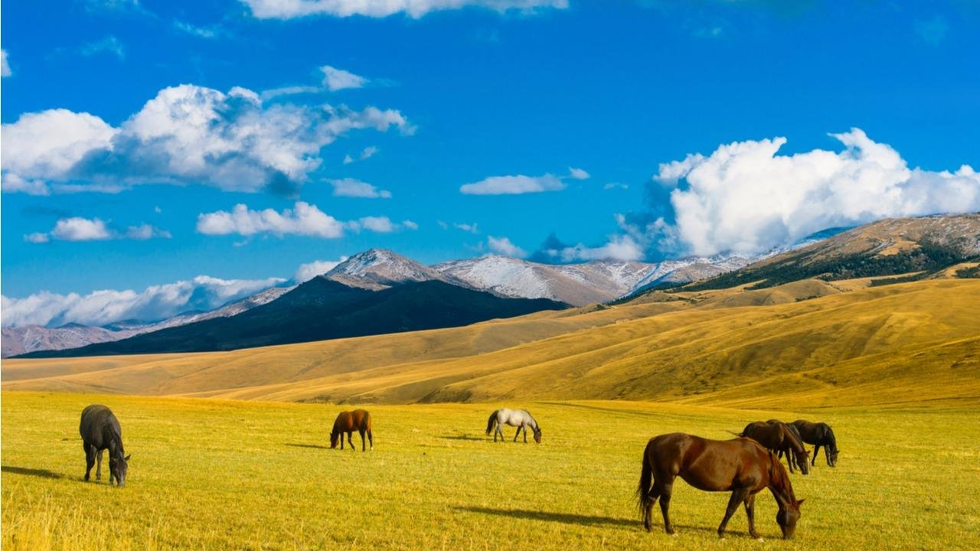
Natural world
The nature of Kazakhstan is incredibly amazing. Crystal clear lakes, endless steppes and mighty mountains. It is great!

Slide 7
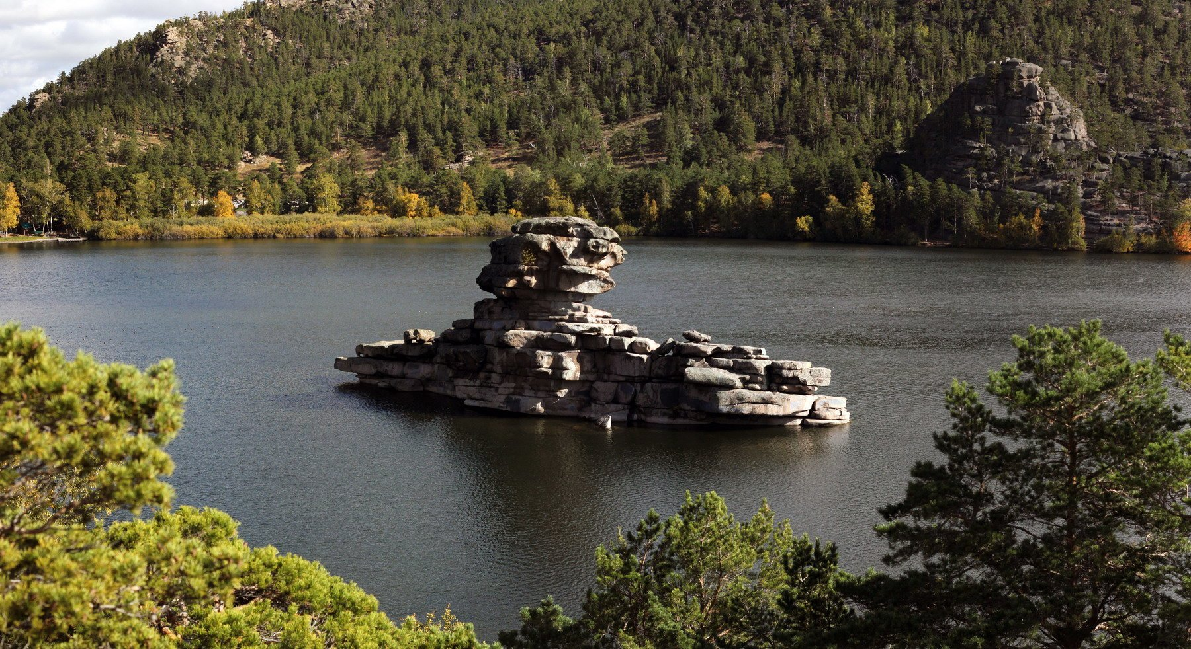
Among the steppes of Northern Kazakhstan there is the village of Burabay. This is a place with incredibly beautiful nature and clean air. One such natural object is the Zhumbaktas rock. There is one legend about her appearance. They say once a guy and a girl fell in love with each other, but the girl’s father was against it. And then the lovers ran away and settled on the shore of the lake. The troops sent by the father found the lovers and at that moment an arrow pierced the guy heart. The girl could not live without him and threw herself into the lake.
Since then, the rock has stood in the middle of the lake. This rock on one side looks like a girl, on the other like a boat, but everyone sees something different in it.

Slide 8
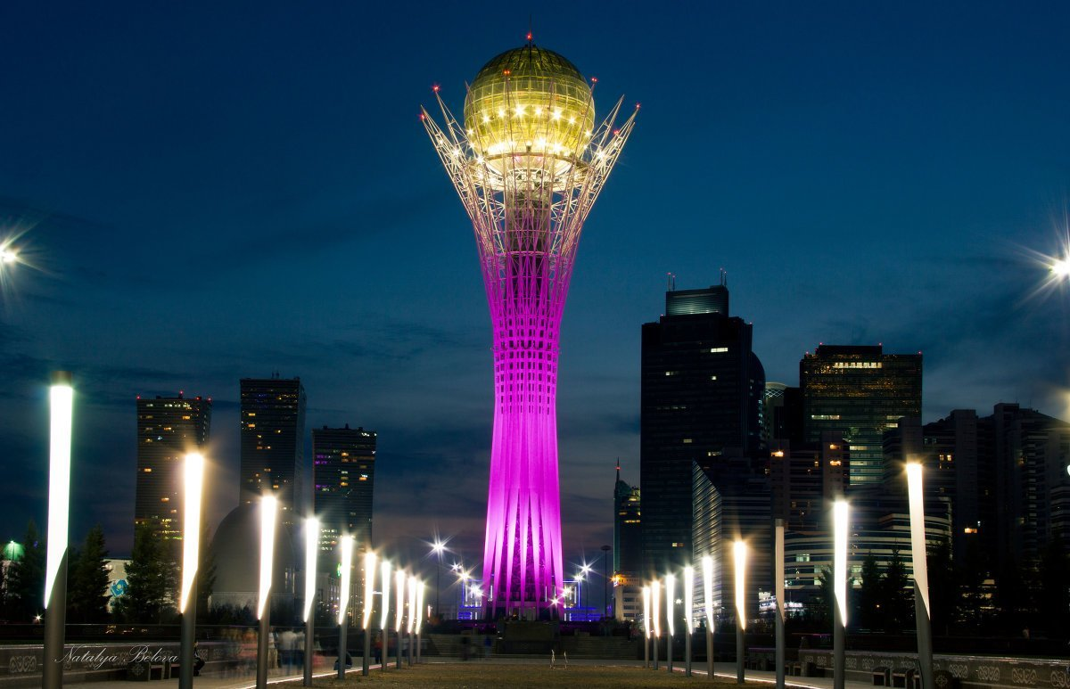
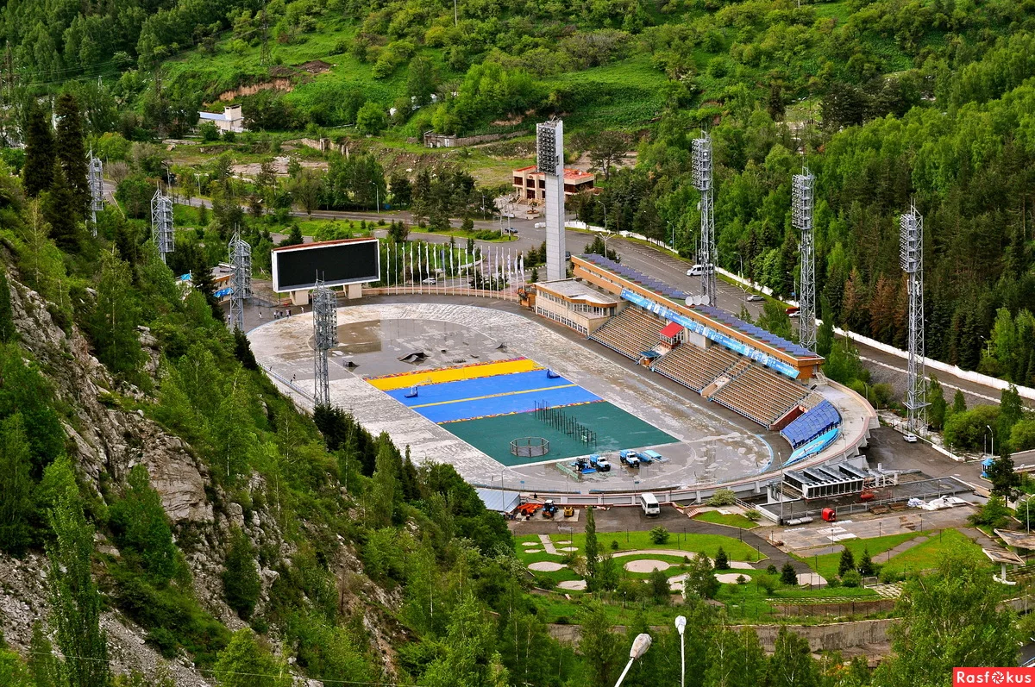
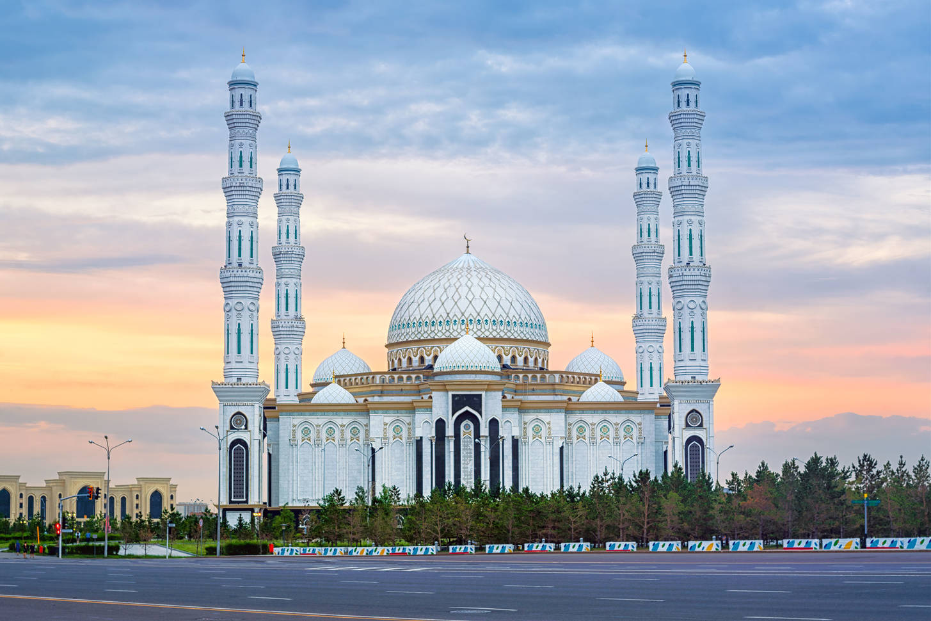
Attractions
Baiterek. Baiterek is a monument and observation tower in Astana. Its height is 97 meters. It was built in 2002.
Sports complex Medeo. This is the highest operating stadium. This is 10,500 square meters of ice at an altitude of 1691 meters.
Khazret Sultan Mosque. The largest mosque in Central Asia, the creation of which involved more 1,500 people.

Slide 9
Welcome to Kazakhstan, Friends!

